Slide 1
Cryptography and Network Security
(Various Hash Algorithms)

Slide 2
Hash Functions
condenses arbitrary message to fixed size
  h = H(M)
usually assume hash function is public
hash used to detect changes to message
want a cryptographic hash function
  computationally infeasible to find data mapping to specific hash (one-way property)
  computationally infeasible to find two data to same hash (collision-free property)
Notes:
A hash function H accepts a variable-length block of data M as input and produces a fixed-size hash value h = H(M). A "good" hash function has the property that the results of applying the function to a large set of inputs will produce outputs that are evenly distributed, and apparently random. In general terms, the principal object of a hash function is data integrity. A change to any bit or bits in M results, with high probability, in a change to the hash code. The kind of hash function needed for security applications is referred to as a cryptographic hash function. A cryptographic hash function is an algorithm for which it is computationally infeasible (because no attack is significantly more efficient than brute force) to find either (a) a data object that maps to a pre-specified hash result (the one-way property) or (b) two data objects that map to the same hash result (the collision-free property). Because of these characteristics, hash functions are often used to determine whether or not data has changed.

Slide 3
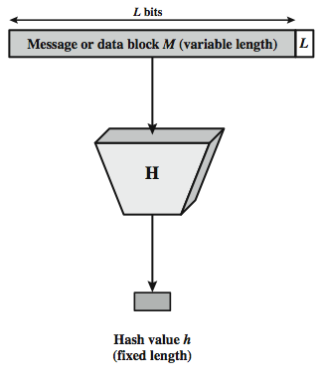
Cryptographic Hash Function
Notes:
Stallings Figure 11.1 depicts the general operation of a cryptographic hash function. Typically, the input is padded out to an integer multiple of some fixed length (e.g., 1024 bits) and the padding includes the value of the length of the original message in bits. The length field is a security measure to increase the difficulty for an attacker to produce an alternative message with the same hash value.

Slide 4
Hash Function Uses
Message Integrity Check (MIC)
  send hash of message (digest)
  MIC always encrypted, message optionally
Message Authentication Code (MAC)
  send keyed hash of message
  MAC, message optionally encrypted
Digital Signature (non-repudiation)
  Encrypt hash with private (signing) key
  Verify with public (verification) key
Notes:
Hash functions are commonly used to create a one-way password file. Chapter 20 explains a scheme in which a hash of a password is stored by an operating system rather than the password itself. Thus, the actual password is not retrievable by a hacker who gains access to the password file. In simple terms, when a user enters a password, the hash of that password is compared to the stored hash value for verification. This approach to password protection is used by most operating systems.
Hash functions can be used for intrusion detection and virus detection. Store H(F) for each file on a system and secure the hash values (e.g., on a CD-R that is kept secure). One can later determine if a file has been modified by recomputing H(F). An intruder would need to change F without changing H(F).
A cryptographic hash function can be used to construct a pseudorandom function (PRF) or a pseudorandom number generator (PRNG). A common application for a hash-based PRF is for the generation of symmetric keys. We discuss this application in Chapter 12.

Slide 5
A birthday attack is a cryptanalytic technique. Birthday attacks can be used to find collisions in a cryptographic hash function. For instance, suppose we have a hash function which, when supplied with a random input, returns one of k equally likely values.

Slide 6
Birthday Attacks
might think a 64-bit hash is secure
Hash code
but by Birthday Paradox is not
birthday attack works thus:
  opponent generates 2^{m/2} variations of a valid message all with essentially the same meaning
  opponent also generates 2^{m/2} variations of a desired fraudulent message
  two sets of messages are compared to find pair with same hash (probability > 0.5 by birthday paradox)
  have user sign the valid message, then substitute the forgery which will have a valid signature
conclusion is that need to use larger MACs
Notes:
The Birthday Attack exploits the birthday paradox – the chance that in a group of people two will share the same birthday – only 23 people are needed for a Pr>0.5 of this. Can generalize the problem to one wanting a matching pair from any two sets, and show need 2^{m/2} in each to get a matching m-bit hash.
Note that creating many message variants is relatively easy, either by rewording or just varying the amount of white-space in the message.

Slide 7
Hash Function Properties
a Hash Function produces a fingerprint of some file/message/data
  h = H(M)
  condenses a variable-length message M
  to a fixed-sized(512) fingerprint
assumed to be public
Decryption/Reverse is not possible

Slide 8
Requirements for Hash Functions
can be applied to any sized message M
produces fixed-length output h
is easy to compute h=H(M) for any message M
given h is infeasible to find x s.t. H(x)=h
  one-way property //plain text cannot be obtained using hash code
given x is infeasible to find y s.t. H(y)=H(x) //Same Hash Code for 2 different message
  weak collision resistance
is infeasible to find any x,y s.t. H(y)=H(x) //different hash code
  strong collision resistance
Notes:
These are the specifications for good hash functions. Essentially it must be extremely difficult to find 2 messages with the same hash, and the hash should not be related to the message in any obvious way (ie it should be a complex non-linear function of the message). There are quite a few similarities in the evolution of hash functions & block ciphers, and in the evolution of the design requirements on both.

Slide 9
Hash Algorithms
similarities in the evolution of hash functions & block ciphers
  increasing power of brute-force attacks
  leading to evolution in algorithms
  from DES to AES in block ciphers
  from MD4 & MD5 to SHA-1 & RIPEMD-160 bits in hash algorithms
likewise tend to use common iterative structure as do block ciphers

Slide 10
MD5
designed by Ronald Rivest (the “R” in RSA)
latest in a series of MD2, MD4
produces a 128-bit hash value
until recently was the most widely used hash algorithm
  in recent times have both brute-force & cryptanalytic concerns
specified as Internet standard RFC1321
Notes:
MD5 is the current, and very widely used, member of Rivest’s family of hash functions.

Slide 11
MD5 Overview
pad message so its length is 448 mod 512
append a 64-bit length value to message
initialise 4-word (128-bit) MD buffer (A,B,C,D)
process message in 16-word (512-bit) blocks:
  using 4 rounds of 16 bit operations on message block & buffer
  add output to buffer input to form new buffer value
output hash value is the final buffer value
Notes:
The padded message is broken into 512-bit blocks, processed along with the buffer value using 4 rounds, and the result added to the input buffer to make the new buffer value. Repeat till run out of message, and use final buffer value as hash. nb. due to padding always have a full final block (with length in it).

Slide 12
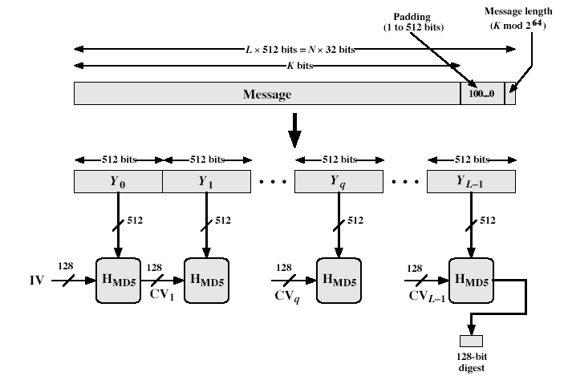
MD5 Overview
Notes:
Stallings Fig 12-1.

Slide 13
MD5 Compression Function
each round has 16 steps of the form:
  a = b+((a+g(b,c,d)+X[k]+T[i])<<<s)
a,b,c,d refer to the 4 words of the buffer, but used in varying permutations
  note this updates 1 word only of the buffer
  after 16 steps each word is updated 4 times
where g(b,c,d) is a different nonlinear function in each round (F,G,H,I)
T[i] - table is a constant value derived from sin
4 Registers and 4 nonlinear functions.
Notes:
Each round mixes the buffer input with the next "word" of the message in a complex, non-linear manner. A different non-linear function is used in each of the 4 rounds (but the same function for all 16 steps in a round). The 4 buffer words (a,b,c,d) are rotated from step to step so all are used and updated. g is one of the primitive functions F,G,H,I for the 4 rounds respectively. X[k] is the kth 32-bit word in the current message block. T[i] is the ith entry in the matrix of constants T. The addition of varying constants T and the use of different shifts helps ensure it is extremely difficult to compute collisions.

Slide 14
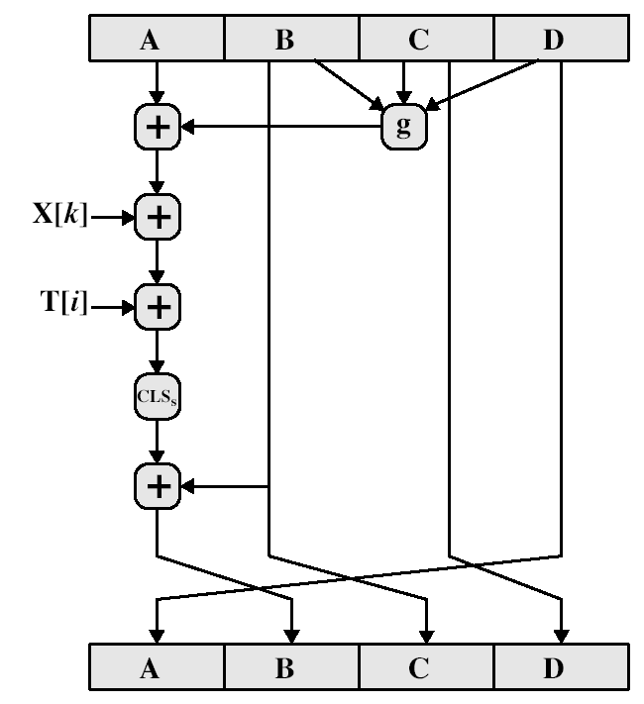
MD5 Compression Function
Notes:
Stallings Fig 12-3.

Slide 15
MD4
precursor to MD5
also produces a 128-bit hash of message
has 3 rounds of 16 steps versus 4 in MD5
design goals:
  collision resistant (hard to find collisions)
  direct security (no dependence on "hard" problems)
  fast, simple, compact
  favors little-endian systems (eg PCs)
Notes:
MD4 is the precursor to MD5, and was widely used. It uses 3 instead of 4 rounds, and the round functions are a little simpler. In creating MD5 Rivest aimed to strengthen the algorithms by introducing the extra round, and varying the constants used.

Slide 16
Strength of MD5
MD5 hash is dependent on all message bits
Rivest claims security is good as can be
known attacks are:
  Berson 92 attacked any 1 round using differential cryptanalysis (but can’t extend)
  Boer & Bosselaers 93 found a pseudo collision (again unable to extend)
  Dobbertin 96 created collisions on MD compression function (but initial constants prevent exploit)
conclusion is that MD5 looks vulnerable soon
Notes:
Some progress has been made analysing MD5, which along with the hash size of 128-bits means its starting to look too small. Hence interest in hash functions that create larger hashes.

Slide 17
Secure Hash
Algorithm (SHA-1)
SHA was designed by NIST & NSA in 1993, revised 1995 as SHA-1
US standard for use with DSA signature scheme
  standard is FIPS 180-1 1995, also Internet RFC3174
  note: the algorithm is SHA, the standard is SHS
produces 160-bit hash values
now the generally preferred hash algorithm
based on design of MD4 with key differences
Notes:
SHA is one of the newer generation of hash functions, more resistant to cryptanalysis, and now probably preferred for new applications.

Slide 18
SHA Overview
pad message so its length is 448 mod 512
append a 64-bit length value to message
initialise 5-word (160-bit) buffer (A,B,C,D,E) to
  (67452301,efcdab89,98badcfe,10325476,c3d2e1f0)
process message in 16-word (512-bit) chunks:
  expand 16 words into 80 words by mixing & shifting
  use 4 rounds of 20 bit operations on message block & buffer
  add output to input to form new buffer value
output hash value is the final buffer value
Notes:
Note that the SHA-1 Overview is very similar to that of MD5.

Slide 19
SHA-1 Compression Function
each round has 20 steps which replaces the 5 buffer words thus:
  (A,B,C,D,E) <-(E+f(t,B,C,D)+(A<<5)+W_{t}+K_{t}),A,(B<<30),C,D)
a,b,c,d,e refer to the 5 words of the buffer
t is the step number
f(t,B,C,D) is nonlinear function for round
W_{t} is derived from the message block
K_{t} is a constant value derived from sin
Notes:
Can see SHA shares much in common with MD4/5, but with 20 instead of 16 steps in each of the 4 rounds. Note the 4 constants are based on sqrt(2,3,5,10). Note also that instead of just splitting the input block into 32-bit words and using them directly, SHA-1 shuffles and mixes them using rotates & XOR’s to form a more complex input, and greatly increases the difficulty of finding collisions.

Slide 20
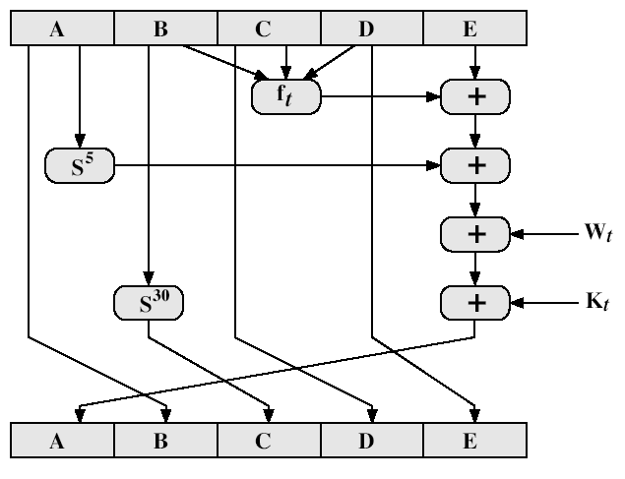
SHA-1 Compression Function
Notes:
Stallings Fig 12-6.

Slide 21
SHA-1 verses MD5
brute force attack is harder (160 vs 128 bits for MD5)
not vulnerable to any known attacks (compared to MD4/5)
a little slower than MD5 (80 vs 64 steps)
both designed as simple and compact
optimised for big endian CPU's (vs MD5 which is optimised for little endian CPU’s)
Notes:
Compare using the design goals listed earlier.
SHA-1 is probably the preferred hash function for new applications. Currently no problems are known with it.

